Slide 1
SIGN LANGUAGE INTERPRETER

Slide 2
AGENDA
Introduction
Features
Working
Challenges
Future Work

Slide 3
INTRODUCTION
Sign Language Interpreter Uses live video feed from the camera and interpret sign language i.e. convert hand signs into normal text.
This can be very helpful for the deaf and dumb people in communicating with others as knowing sign language is not something that is common to all.

Slide 4
FEATURES
Recognize Hand Signs from live video feed.
Recognize multiple Signs at once.

Slide 5
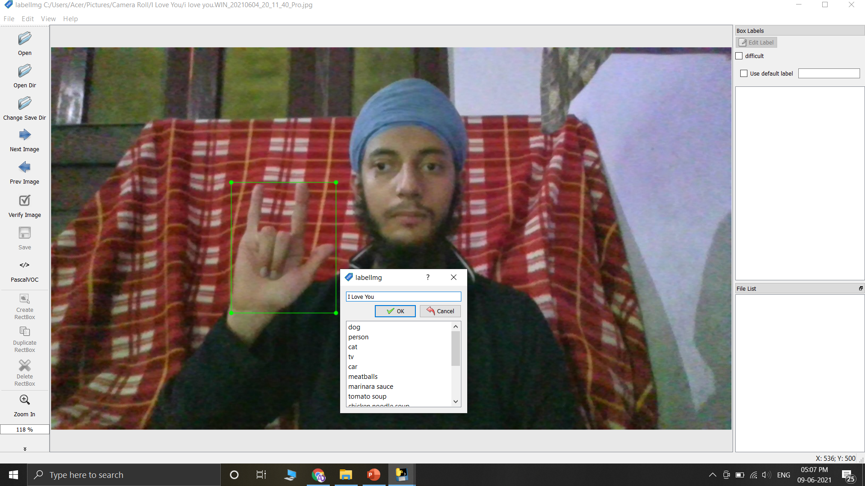
WORKING
Prepare image labels using labelImg.

Slide 6
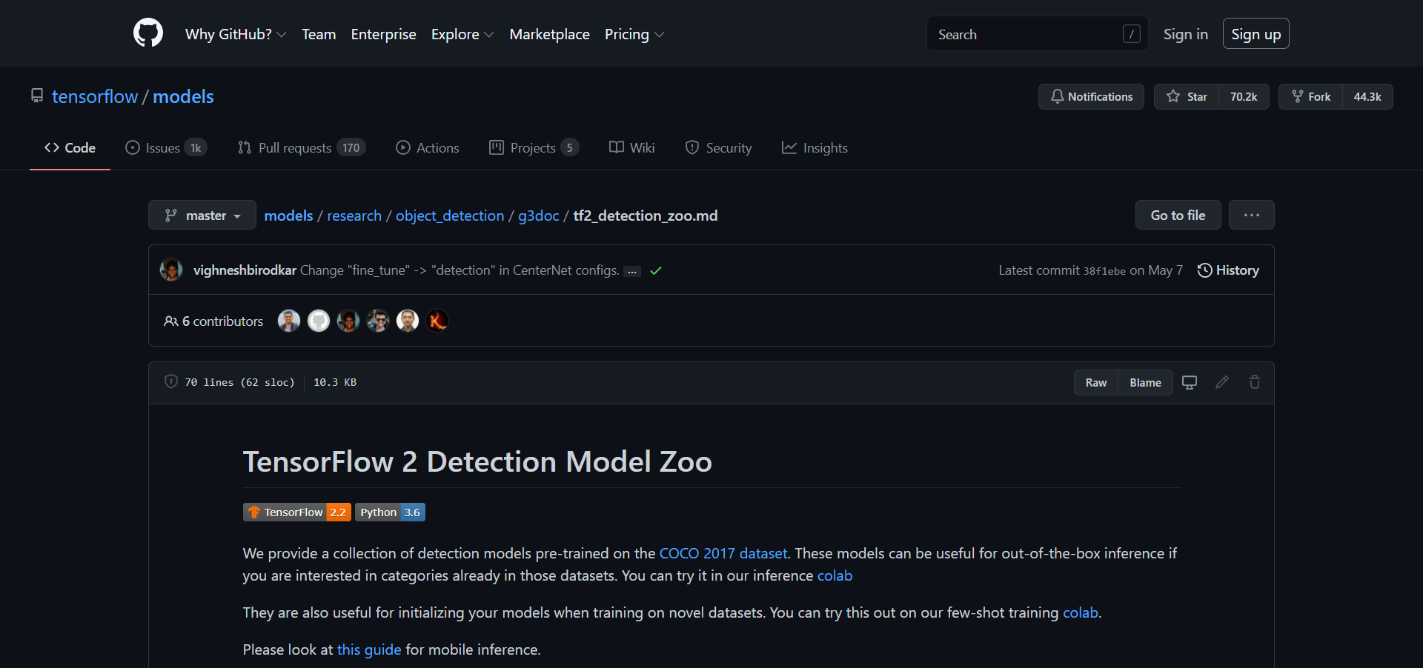
WORKING
Transfer Learning using SSD MobileNet.

Slide 7
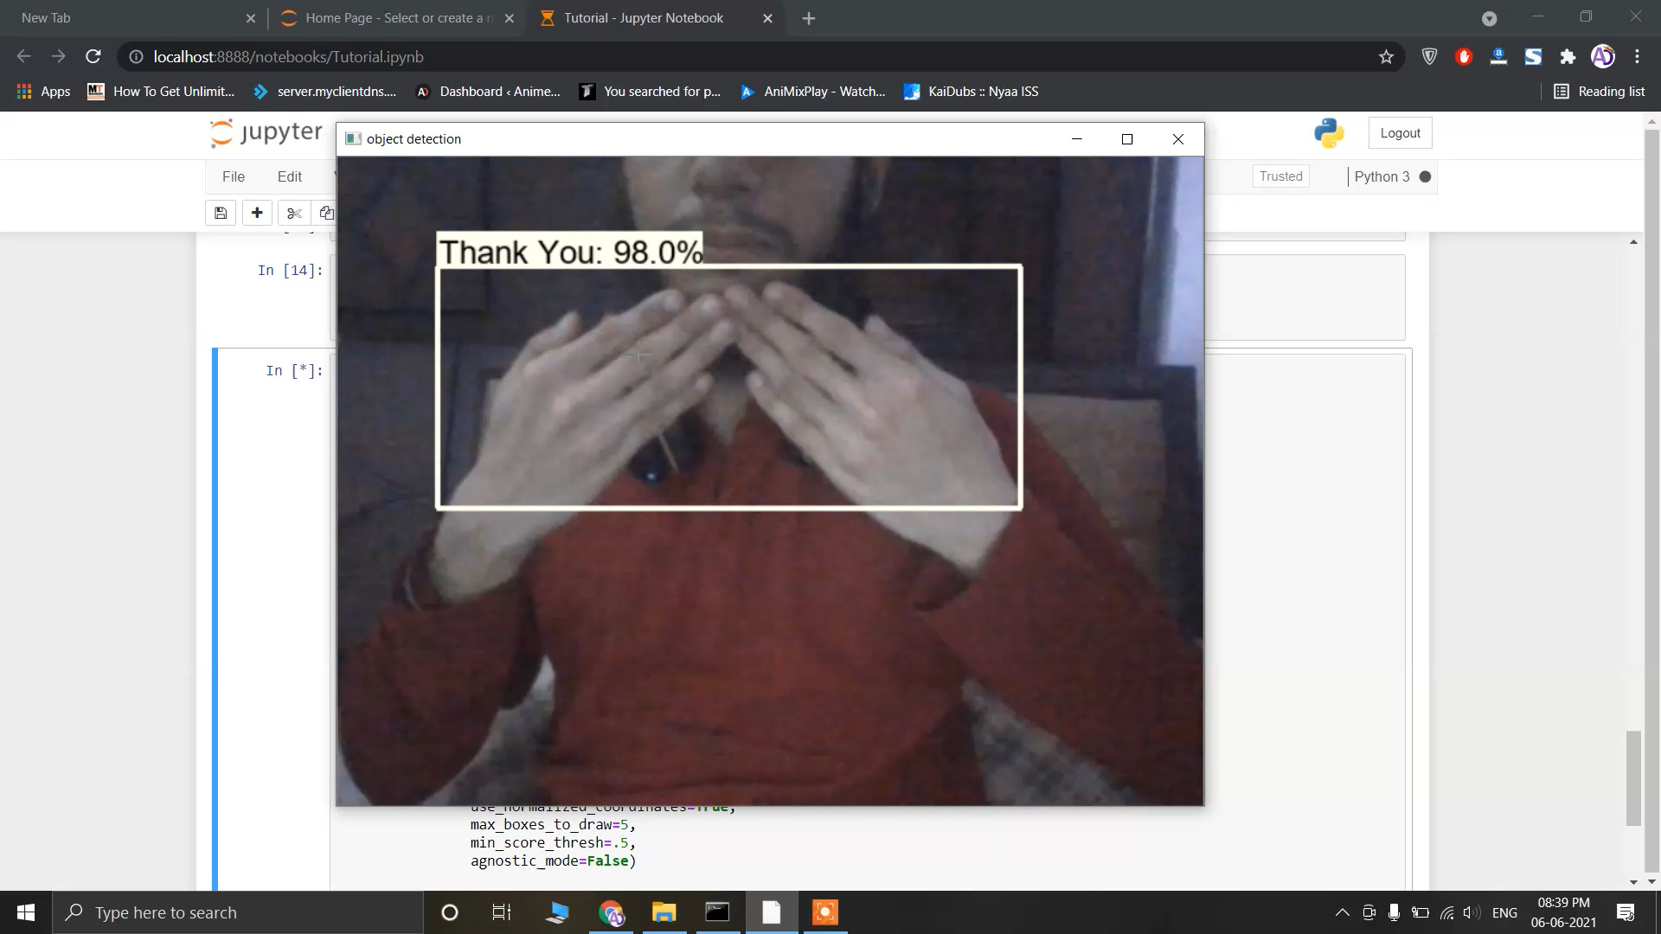
WORKING
Real time detection using OpenCV and a webcam.

Slide 8
CHALLENGES
Accuracy of recognizing hand signs.
Long Running time.
Installing specific libraries and modules to ensure compatibility.

Slide 9
FUTURE WORK
Add more hand signs.
Increase detection accuracy.

Slide 10
THANK YOU…
Sukhmeet Singh
Prikshat Kumar
Sonu Pandit

